Slide 1
Text Classification in the LLM Era: Where Do We Stand?
RESEARCH PAPER OVERVIEW
Do we still need to train classifiers, or can we just prompt a big model?
Vajjala & Shimangaud · National Research Council Canada / McGill · arXiv 2502.11830 (Feb 2025)
Notes:
One-line pitch: the authors test every common way to build a text classifier (prompting LLMs, few-shot training, synthetic data, full training) on 32 datasets in 8 languages, to tell practitioners what to use when.

Slide 2
Why this paper: gaps and questions
Research gaps
Four research questions
Most LLM classification studies use English only
Most use proprietary models (GPT-3.5/4), few open LLMs
Zero-shot, few-shot, synthetic data and full training are rarely compared together
Few tests with many labels (50+ classes)
Zero-shot LLM vs a classifier trained on all data?
Does few-shot fine-tuning beat zero-shot?
Does a synthetic-data classifier beat zero-shot?
Is fine-tuning an LLM the way to go?
Notes:
Labeled data is expensive, so people hope LLMs can classify with no training. The paper checks that hope fairly, across languages and with open models, not just English and GPT-4.

Slide 3
Setup: 4 datasets × 8 languages = 32 datasets
Dataset | Task | Classes | Text type
SENTIMENT | Positive / negative / neutral | 3 | Tweets
TAXI1500 | Topic of a sentence (faith, sin, grace…) | 6 | Bible sentences
SCENARIO | Domain of a request (music, alarm…) | 18 | Voice commands
INTENT | Exact user intent | 60 | Voice commands
Languages
Arabic · English · French · German · Hindi · Italian · Portuguese · Spanish
Metric: accuracy. Models are trained per language, on top of multilingual pre-trained models.
Notes:
The tasks go from easy-looking (3 classes) to hard (60 classes). That spread lets the authors see how the number of labels changes which method wins. 7 of 8 languages are Indo-European.

Slide 4
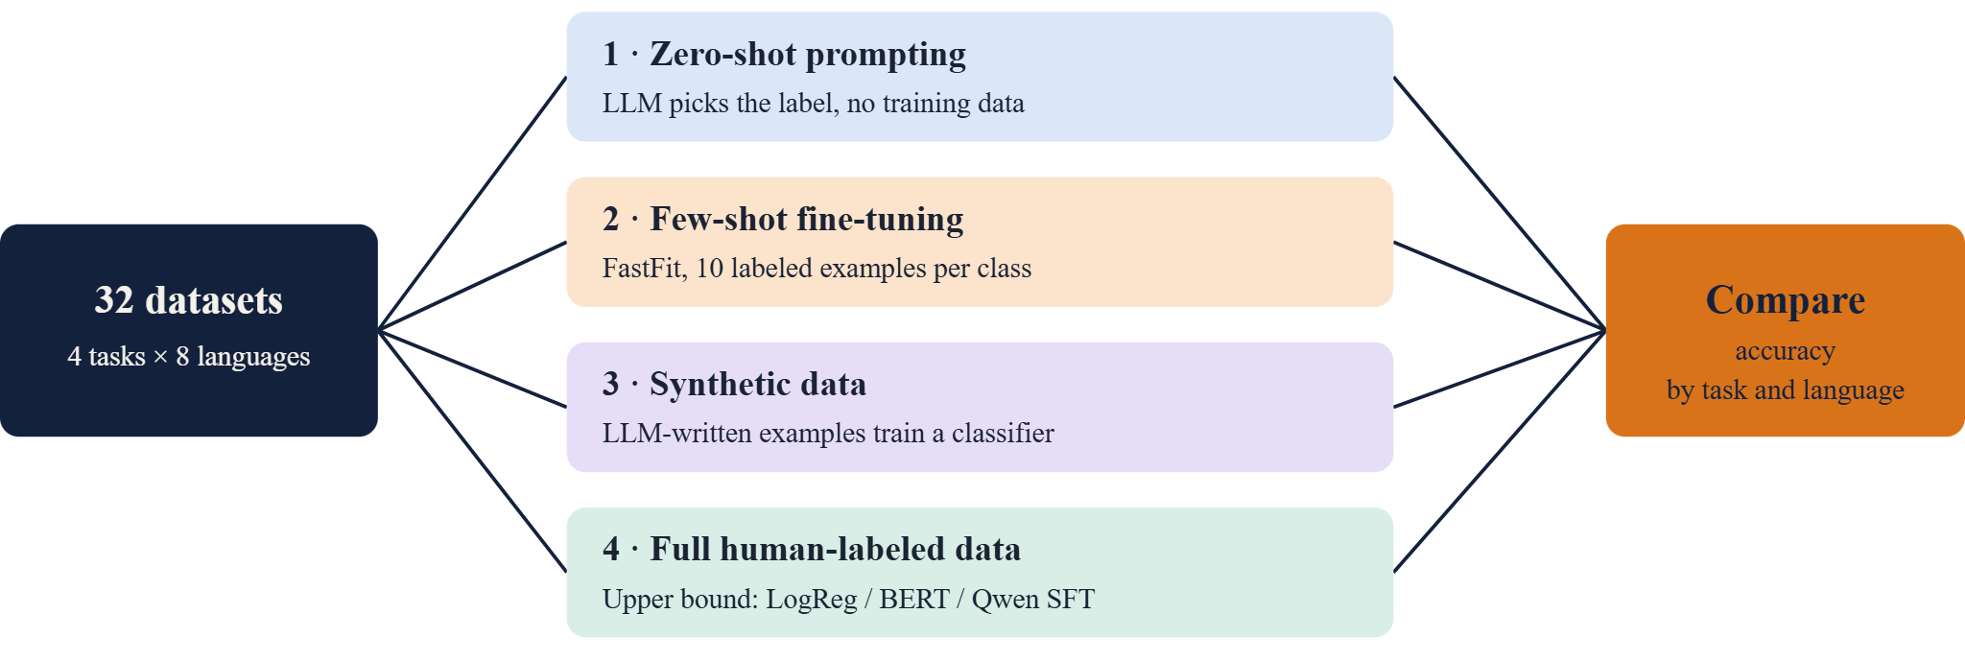
Architecture: the overall study design
Notes:
Walk left to right: same datasets go into four different ways of building a classifier, and everything is compared on accuracy. Approach 4 is the reference point: what you get if you have lots of labeled data.

Slide 5
How each approach works
1 · Zero-shot prompting
2 · Few-shot (FastFit)
Ask an LLM to name the label. Models: GPT-4, Qwen2.5-7B, Aya-23-8B, Aya-Expanse-8B. The Instructor library forces a valid label; extra explanations count as errors.
Only 10 labeled texts per class. Contrastive learning plus token similarity teaches the model to match texts to labels. Trains in 5–15 minutes on a laptop.
3 · Synthetic data
4 · Full-data classifiers
GPT-4, Qwen and Aya-Expanse each write labeled examples from one prompt. A normal classifier is then trained on that generated data only.
Logistic regression on gte-multilingual embeddings, fine-tuned multilingual BERT, and instruction-tuned Qwen2.5-7B (SFT). Trained on real or synthetic data.
Notes:
Zero-shot means no training examples at all. Few-shot means a tiny handful. Synthetic means an LLM invents the training set. Full data means the original human-labeled training set, thousands of examples per language.

Slide 6
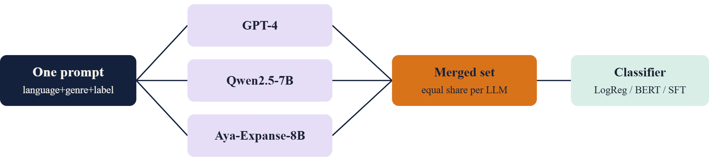
Architecture: synthetic data from several LLMs
Qwen was the best single source with few labels (Twitter 0.51, Taxi 0.43)
GPT-4 was steady everywhere and best with many labels (Intent 0.53)
Mixing all three beat any single source, and two are small local models
Notes:
The prompt is simple: write a text in language X, in the style of Y, belonging to category Z, under 50 words. Using three LLMs gives more varied data, and two of them run free on a laptop, which keeps costs down.

Slide 7
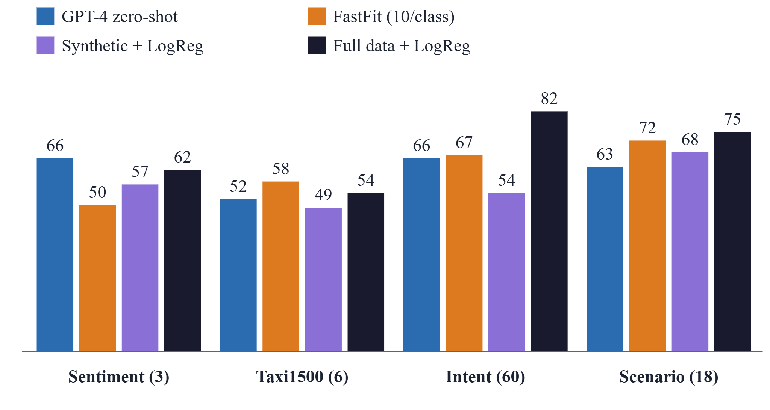
Results: accuracy by approach (avg. of 8 languages)
Few classes: zero-shot GPT-4 beats full-data training on sentiment (66 vs 62)
Many classes: full data wins big (Intent 82 vs 66)
10 examples per class match or beat GPT-4 on 3 of 4 tasks
Notes:
Read the chart by task. On sentiment the LLM is as good as training. As the label count grows, trained models pull ahead. Few-shot FastFit and synthetic data sit in between and often beat zero-shot. Bars are averages I computed from the paper's appendix tables, rounded.

Slide 8
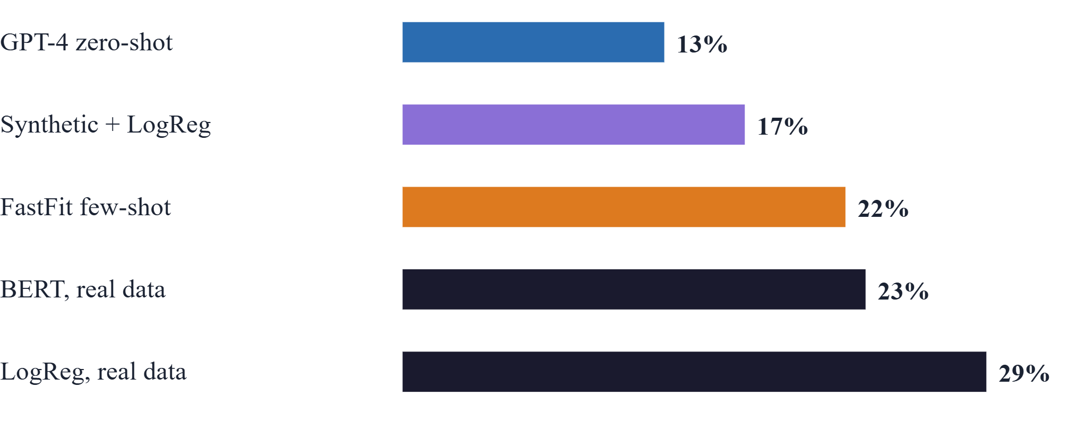
Language gaps: best vs worst language
Same model, big swings: BERT on Taxi1500 scores 77% in English but 35% in Italian
Arabic and Hindi are often weakest; they also cost up to 3× more tokens to generate
Notes:
Gap = accuracy of the best language minus the worst, averaged over the four tasks. Prompting and synthetic data vary least. Likely causes the authors suggest: weaker multilingual embeddings and different scripts and writing direction.

Slide 9
Guidelines for practitioners
1 · Sentiment
2 · Little labeled data
Just prompt an LLM; it beats task-specific training.
Label about 10 per class and run FastFit; it beats zero-shot elsewhere.
3 · No labeled data
4 · Plenty of labeled data
Generate synthetic data from several LLMs; it beats open-LLM zero-shot.
Train on it. Fine-tuned LLMs win with many classes; logistic regression is a cheap strong baseline.
Notes:
This is the take-home slide. Labeled data still wins when you have it; LLMs are most useful for simple, subjective tasks like sentiment, or as data generators when labels are missing.

Slide 10
Limitations and future work
Limitations
Future work
One prompt, short texts only
7 of 8 languages are Indo-European
Open LLMs are small (7–8B) next to GPT-4
Single runs, no quality review of synthetic text
More languages and language families
Multi-label datasets
Longer documents
Few-shot prompting and larger open LLMs
Bottom line: labeled data still matters; LLMs are a strong shortcut when labels are scarce.
Notes:
Be upfront about scope: results are for short texts and mostly Indo-European languages. The authors note the small open LLMs should not be read as a verdict against open models.

